Slide 1
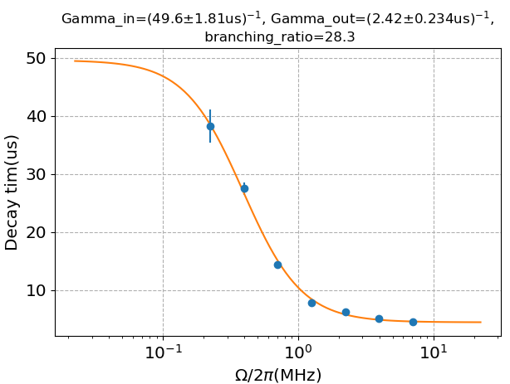
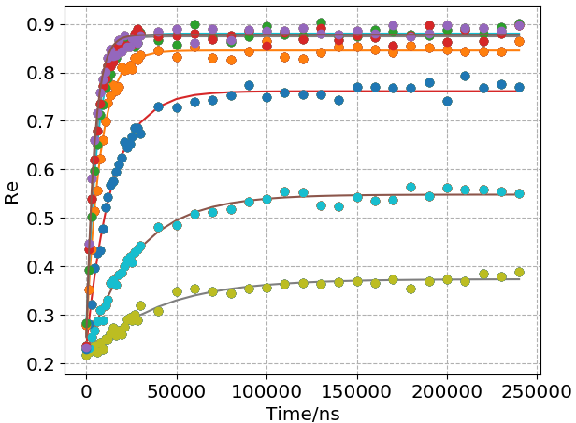
Date: Nov. 24th, 0.5Phi_0
Good things: good fit and low power transient is consistent with T1
Bad things: higher power transient is fast (maybe need to use 3-1 quasiparticle to explain)

Slide 2
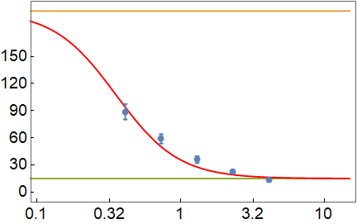
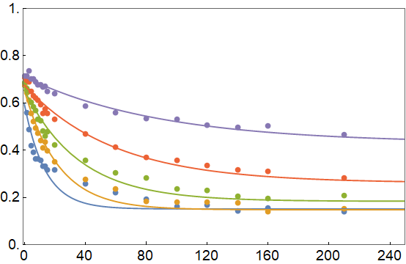
Date: Feb. 2nd 0.505Phi_0
Good things: branching ratio is 92
Bad things: low power transient is not consistent with T1, doesn’t fit single exponential well

